Slide 1
Unit 2 ARRAYS
BY :
MRS. DEEPTI A. CHAUDHARI

Slide 2
NEED OF ARRAYS :
An array is a collection of similar data elements, it means it can hold group of integers, group of characters etc.
Suppose , we wish to read and store three integers, then one may define three variables of integer type.
eg. Int a, int b, int c;
Now if we wish to hold twenty integers , its difficult to define twenty variables and to remember which variable is holding what value , it is a big task for any programmer.
So in this case, we think of using arrays.

Slide 3
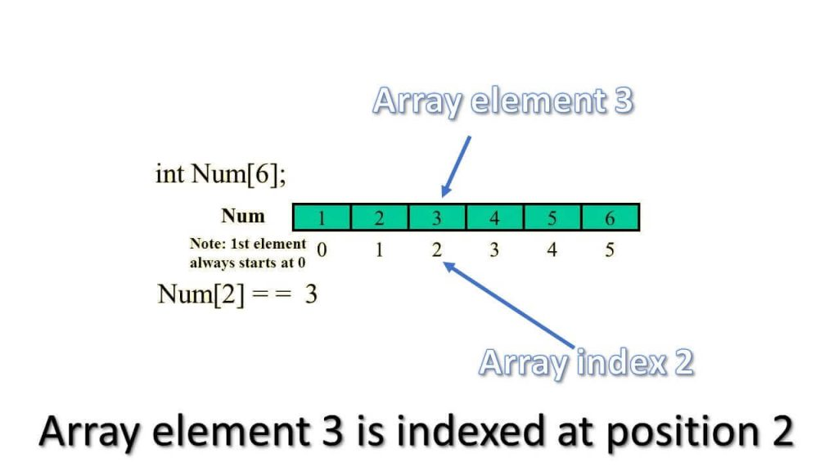
Declaration of an Array :
An array is declared as ,
datatype name [size];

Slide 4
Display integers using an array
#include<stdio.h>
Void main()
{
int i, a[10];
clrscr();
for(i=0; i<5; i++)
{
printf(“Enter value %d : “, i+1);
scanf(“%d”, &a[i]);
printf(“\n”);
}
for(i =0; i<5; i++)
{
printf(“ value %d =%d\n”, i+1, a[i]);
}
getch();
}
Output :
Enter value 1 : 5
Enter value 2 : 6
Enter value 3 : 3
Enter value 4 : 4
Enter value 5 : 2
Value 1 = 5
Value 2 = 6
Value 3 = 3
Value 4 = 4
Value 5 = 2

Slide 5
Initialisation of ARRAY
While using arrays we can accept values from user and we can also initialised array when we declared it.
int a[5] = { 4, 7, 2, 11, 13 };
If we want to print square of given numbers in array :
printf(“ Numbers \t Square \n”);
For(i=0; i<5;i++)
{
Printf(“%d \t “, a[i]);
printf(“%d \n”, a[i] *a[i]);
}

Slide 6
Sum of array values
int I, sum =0, num[10];
Printf(“ enter the 10 array values”);
For(i=0; i<10;i++)
{
scanf(“%d”,&num[i]);
sum = num[i] + sum;
}
Printf(“ Sum of values of array is : %d”, sum);

Slide 7
Find maximum number in array :
STEP 1: START
STEP 2: INITIALIZE arr[] = {25, 11, 7, 75, 56}
STEP 3: length= sizeof(arr)/sizeof(arr[0])
STEP 4: max = arr[0]
STEP 5: SET i=0. REPEAT STEP 6 and STEP 7 i<length
STEP 6: if(arr[i]>max) max=arr[i]
STEP 7: i=i+1.
STEP 8: PRINT "Largest element in given array:" assigning max.
STEP 9: RETURN 0
STEP 9: END.

Slide 8
Passing arrays to Function
Functions are the methods which are called from main ().
Functions has prototype as
return data type func_name(arg1, arg2,..);
Function has to be declared in main () before it call.
Declaration is like :
int add(int a, int b);
If not returning a value use void datatype.

Slide 9
Continued……
#include <stdio.h>
#include <conio.h>
void main()
{
int a[5]={10,5,45,12,19};
int n=5,m;
Int max(int a[],int n);
clrscr();
m=max(a,n);
printf("\n MAXIMUM NUMBER IS %d", m);
getch();
}
int max(int x[],int k)
{
int t, i;
t = x[0];
for(i=1; i<k; i++)
{
if(x[i]>t)
t=x[i];
}
return(t);
}

Slide 10
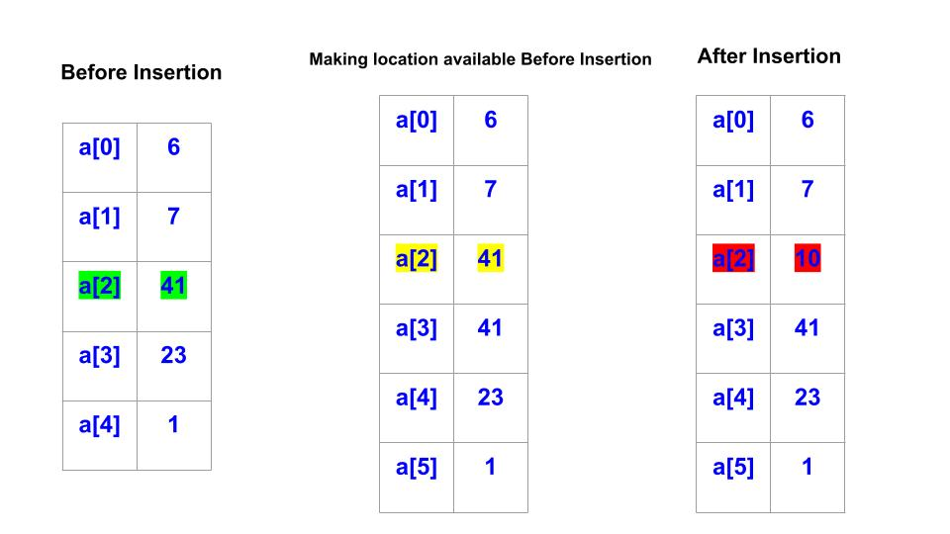
Inserting element in array
For inserting the element at required position, elements must be moved downwards to new locations.

Slide 12
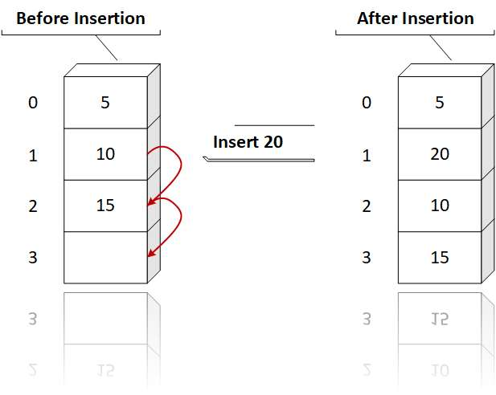
Algorithm to insert value in array :
(initialised the value of i] Set i= len
Repeat for i=len down to pos
( shift the elements down by 1 position)
set a[i+1] = a[i]
(End of loop)
Insert element at required position
set a[pos] =num;
(Reset len) Set len =len+1
Display the new list of arrays
End

Slide 13
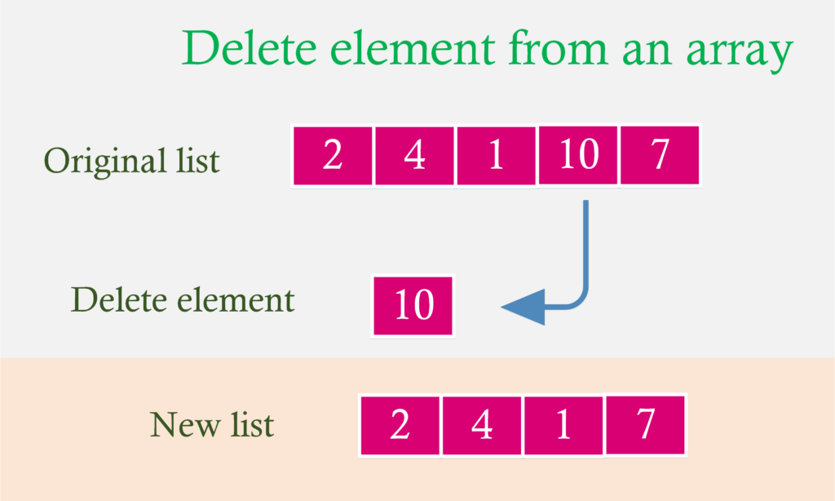
Deleting an Element from array
Algorithm
1. Set item = a[pos]
2. Repeat for j = pos to n-1
[ shifting elements 1 position upwards]
set a[j] = a[j+1] (end of loop)
3. Reset n= n-1
4. Display the new list of element of arrays
5. End

Slide 14
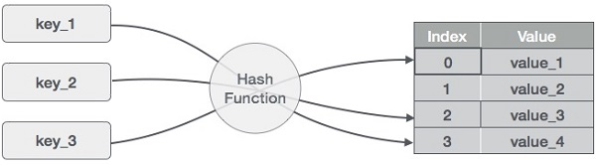
Hash Table
Hash Table is a data structure which stores data in an associative manner.
Hash Table uses an array as a storage medium and uses hash technique to generate an index where an element is to be inserted or is to be located from.
HASHING :
Hashing is a technique to convert a range of key values into a range of indexes of an array. We're going to use modulo operator to get a range of key values. Consider an example of hash table of size 20, and the following items are to be stored. Item are in the (key,value) format.
(1,20)
(2,70)
(42,80)
(4,25)
(12,44)
(14,32)
(17,11)
(13,78)
(37,98)
Here we can see the key for particular values

Slide 15
Indexing of Hash Table
Sr. no | key | Hash | Array index
1 | 1 | 1 % 20 = 1 | 1
2 | 2 | 2 % 20 = 2 | 2
3 | 42 | 42 % 20 = 2 | 2
4 | 4 | 4 % 20 = 4 | 4
5 | 12 | 12 % 20 = 12 | 12
6 | 14 | 14 % 20 = 14 | 14
7 | 17 | 17 % 20 = 17 | 17
8 | 13 | 13 % 20 = 13 | 13
9 | 37 | 37 % 20 = 17 | 17

Slide 16
Linear Probing
As we can see, it may happen that the hashing technique is used to create an already used index of the array. In such a case, we can search the next empty location in the array by looking into the next cell until we find an empty cell. This technique is called linear probing.
Sr.No. | Key | Hash | Array Index | After Linear Probing, Array Index
1 | 1 | 1 % 20 = 1 | 1 | 1
2 | 2 | 2 % 20 = 2 | 2 | 2
3 | 42 | 42 % 20 = 2 | 2 | 3
4 | 4 | 4 % 20 = 4 | 4 | 4
5 | 12 | 12 % 20 = 12 | 12 | 12
6 | 14 | 14 % 20 = 14 | 14 | 14
7 | 17 | 17 % 20 = 17 | 17 | 17
8 | 13 | 13 % 20 = 13 | 13 | 13
9 | 37 | 37 % 20 = 17 | 17 | 18

Slide 17
A[3][3]
3 4 5 1 3 2
1 3 2 2 1 1
6 1 1 4 1 2
A[0][0]= 3
A[0][1]=4
A[0][2]= 5
A[1][0]= 1
A[1][1]= 3
A[1][2]= 2
A[2][0]= 6
A[2][1]= 1
A[2][2]= 1

Slide 18
For(I =1; I < r; i++) r=3
{
for(j = 0; j < 3 ; j++) c=3
{
scanf(“%d\n”,&a[i][j]); a[0][0]= 4
} a[0][1]= 1
a[0][2] =3
a[1][0]= 2
}

